Slide 1


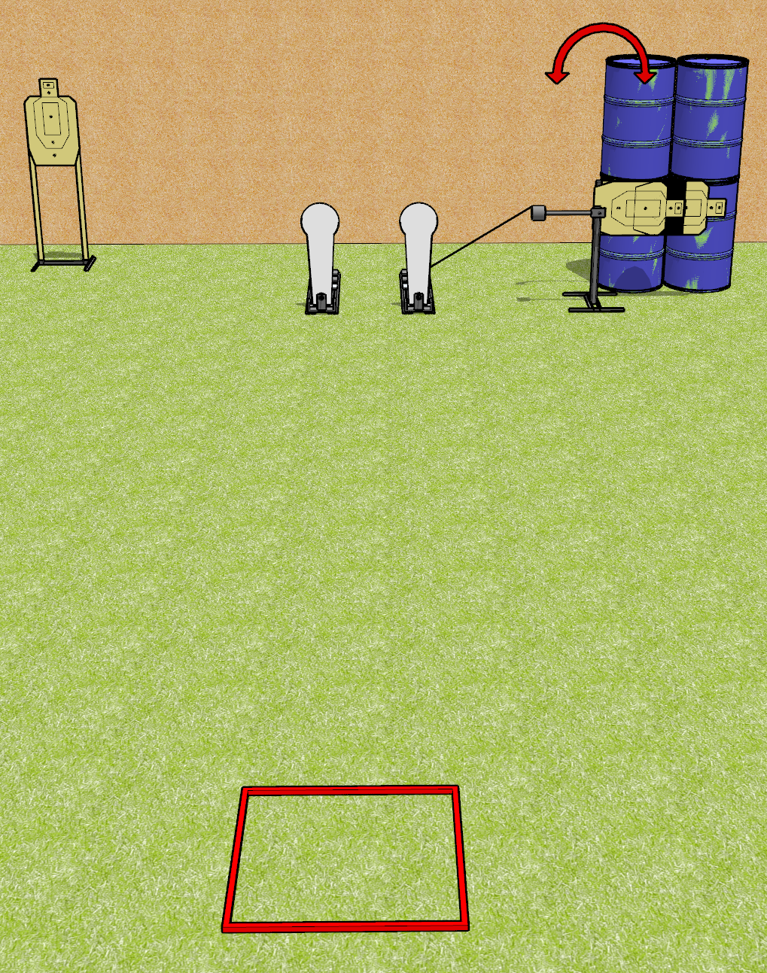
 | Dothan Gun Club – USPSA Match Speedy Meanie Course Designer : Drew Coleman
Round Count 8 rounds 3 USPSA targets 2 colt poppers
Equipment List Swinger 2 USPSA targets cut in half with non-scoring border

Slide 2
Speedy Meanie
Written Stage Briefing
Speedy Meanie is an 8 round, 40 point, Comstock speed shoot. There are 3 USPSA targets and 2 colt poppers. The best 2 hits on paper will score, and steel must fall to score. The start signal is audible.
The swinger is activated by the right colt popper, and remains visible at rest.
Handgun start position is in shooting box with wrists above respective shoulders. Handgun is loaded and holstered.
PCC start position is in shooting box with stock on belt. Loaded carbine is held with both hands, safety on.
On start signal, engage targets as they become available from within the shooting area.

